Slide 1

OGF Enterprise Strategy 2008
Robert Fogel
4/07/2006

Slide 2
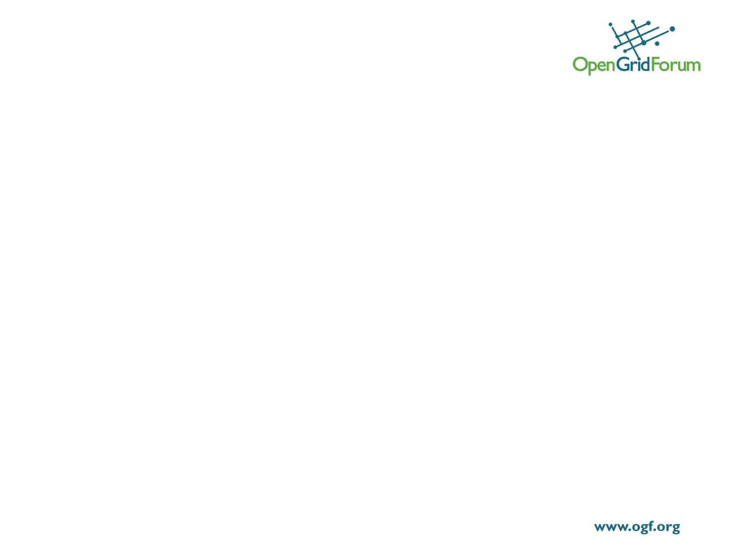
Issues
Maintaining critical mass of people to do the work (OGF Europe may help?)
Balancing between a narrow focus to get things done with very limited resources vs. urgency to be relevant across many topics
Very limited OGF interaction between functions (e.g. TSC) especially below MSC level
OGF Europe activities need to be better integrated
Grids not perceived by ent community to be very relevant anymore (discussion has moved to virtualization and is moving to clouds)

Slide 3
Relevance (Do what the ent community needs/wants)
Topics that the community cares about
  Current uses of technology
    Infrastructure: Enterprise Grid as an approach to Increasing Infrastructure Utilization addressing infrastructure sharing
    Application: Evaluating Application Suitability for an Enterprise Grid and Application Porting/ On-boarding to an Enterprise Grid
    Data: How to solve Data access and high performance issues - caching and storage
  Future/emerging trends
    Clouds
    Virtualization
    SOA

Slide 4
Deliverables (ways to reach ent community)
Use vertical workshops to address select topics
  Outreach (go to their turf)
    Street Grid
    Others
  OGF Hosted (have them come to our turf)
    OGF23 workshops
Use Best Practice (BP) series to gain participation and interest
  Call for submissions on topics above
  Generate BP docs from submissions
Presence (Create awareness/visibility in ent community on OGF and other web sites)
  Take inventory to leverage what we already have
    Current workshop results
    BP and CP docs
    Standards/specifications (e.g. JSDL, HPC Profile, etc.)
  Promote future workshops and BP activity

Slide 5
Interaction (between OGF functions)
Work closely with eScience around future/emerging trends
Work closely with Standards around how BP can be turned into stds
Need to engage OGF Europe to integrate and align activities and agenda

